Slide 1



Facilitating Women's Success in Software Engineering through non-traditional Educational Environments
Arizona Space Grant Symposium​
April 19th, Arizona State University
Taylor Hobbs & Fiya Clerget
Department of Computer, Electrical, Software Engineering, College of Engineering
Chanel Davis
Department of Aerospace Engineering, College of Engineering
Faculty Mentor: Dr. Ashley Rea
Department of Humanities and Communication, College of Arts and Sciences

Slide 2
Introduction
Equity-focused coding spaces are on the rise
Engineering remains one of the least diverse STEM fields
Women make up 56% of undergraduates but only 15.9% of the engineering workforce.
Bootcamps, workshops, and community programs aim to increase access and representation.
Our study highlights inclusive teaching strategies
We analyze how these programs build equity and offer tools for reimagining software engineering education.
Notes:
Full text slide

Slide 3
Research Questions
How is programming literacy understood, taught, and practiced in coding education designed to increase representation, access, and equity in technology outside traditional university programs?
What are the implications of these approaches for software engineering education?
Notes:
Full text slide

Slide 4
Previous Research
AY 2021-2022
AY 2022-2023
AY 2024-2025
Qualitative Study Mapping Major Sites of Coding Education
Qualitative Study on Alternative Sites of Coding Education
AY 2023-2024
Educational Intervention Research in Introductory Engineering Programming Courses
Qualitative Study on Women's Experiences in Introductory Engineering Programming Courses
Notes:
Full text slide

Slide 5




Data Collection & Analysis Methods
Participant observation (Rai & Druschke, 2018)
Qualitative semi-structured interviews (Stake, 2010)
Grounded theory analysis (Saldaña, 2016; Urquhart, 2013 )
Notes:
Full text slide

Slide 6
Data Collection Sites
Case Study | Audience | Focus | Duration | Interview Participants
1 | Women and LGBTQ+ technologists | Professional development (especially public writing and speaking) and opensource software development | A multi-day national conference and meetup events lasting several hours | Drew (organizer); Shannon (participant); Neha (participant); Katherine (participant)
2 | Women in technology | Coding education (on a variety of languages and topics) and professional development | A multi-day international conference and meetup events lasting several hours | Kelsey (organizer); Dana (organizer)
3 | Women of color | Front end web development, user experience, professional development | One-day workshops and multi-week bootcamp held in person and online | Olivia (organizer); Kassandra (participant)
4 | Underrepresented developers (in terms of race, gender, ability, orientation, etc.) | Go lang (object-oriented procedural language developed by Google) | One-day workshop held in person | Sophie (organizer); Danny (instructor)
5 | Women and gender-diverse students, faculty, and staff | Front end web development (HTML, CSS, JavaScript) | Nine-week workshop (series of 2-hour long classes) | Ana (organizer); Julia (instructor)
Notes:
Full text slide

Slide 7
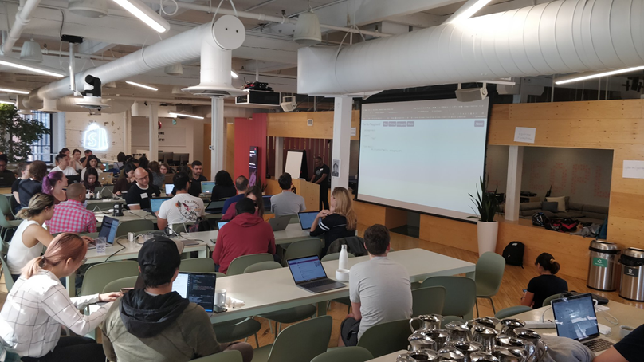
Preliminary Findings
Coding bootcamps and workshops increase access by considering participant's material needs.​
Coding bootcamps and meetups center representation at multiple levels, from class content to instructors and teaching assistants.
Coding bootcamps and meetups build in many opportunities for students to develop relationships in their professional communities.
Coding bootcamps and meetups prioritize affective literacy to encourage confidence in the learner.​
Coding workshop on the Go programming language
Notes:
Inclusive pedagogies are Intentional
Coding organizations design learning environments that prioritize
belonging, access, and flexibility in instruction.
Learning Environments Shape Coding Skills
Participants develop computational thinking through structured,
community-based coding experiences.
Alternative Learning Spaces Fill Gaps
These programs provide mentorship, community, and practical
experience often missing in traditional CS education.

Slide 8

"I’m teaching women how to code. But it’s bigger than that. What I’m really teaching them how to do is how to unlearn what they’ve been taught. A lot of women of color, or women in general, have not been taught that science, math, coding, you name it, is for them. You’re unlearning a thing, and you’re learning a new skill."
—Olivia, Coding Workshop Organizer
Notes:
Quote slide or powerful statement

Slide 9
"You’re not just teaching somebody a programming language on a Saturday morning, you’re introducing them to an entirely different community and ways of talking and collaborating...
It’s never just about syntax. You can learn the syntax in a couple of weeks, [but] that’s not the killer feature of the community. The killer feature is if I need help, can I go into this community and ask a question and have somebody point me in the right direction?"
—Danny, Coding Bootcamp Instructor
Notes:
Quote slide or powerful statement

Slide 10
"We need to be careful as a society not to reduce coding to just the hard skill sets, because a lot of problems come from not marrying the machine understanding with human understanding….
In the 90s you would have computer viruses. They would get transmitted, but you [could] change the machines and make them more virus-proof. Nowadays, [for] things that go viral like fake news on social media, your transmitters are humans, and we can’t reengineer the humans."
—Kassandra, Coding Workshop Participant
Notes:
Quote slide or powerful statement

Slide 11
Implications
Redefining Effective Pedagogy
Guidance for Educators
Equity focus promotes inclusive, student-driven learning.
Bridging Classroom and Career
Prepare students to succeed in tech environments.
Implement low-cost, high-impact strategies to support underrepresented students
Notes:
Full text slide

Slide 12
Challenges
Recent political shifts have led to the closure of many DEI educational programs. This increased pressure and fear of backlash have contributed to fewer individuals willing to speak openly about their diversity and inclusion programming, making it harder to conduct research on equitable education.
Notes:
Full text slide

Slide 13
Future Research
Continue data collection to gather a wide range of participant experiences to represent the shifting equity-focused coding education.
Observe how coding organizations adapt under shifting political pressures.
Investigate how participation in these programs shapes career trajectories and identity over time.
Notes:
Full text slide

